Slide 1


HO CHI MINH UNIVERSITY OF TECHNOLOGY AND EDUCATION
Project on Software Engineering
BUILD AN WEB APPLICATION OF FASHION STORE FOR SELLING FASHIONABLE OUTFIT AND ACCESSORIES
Lecturer : Phd. Nguyễn Thiên Bảo
Members
Phạm Hoàng Phúc | 19110147
Nguyễn Hoàng Sang | 19110120
Nguyễn Anh Đức | 19110118
HO CHI MINH, 4/1/2023

Slide 2
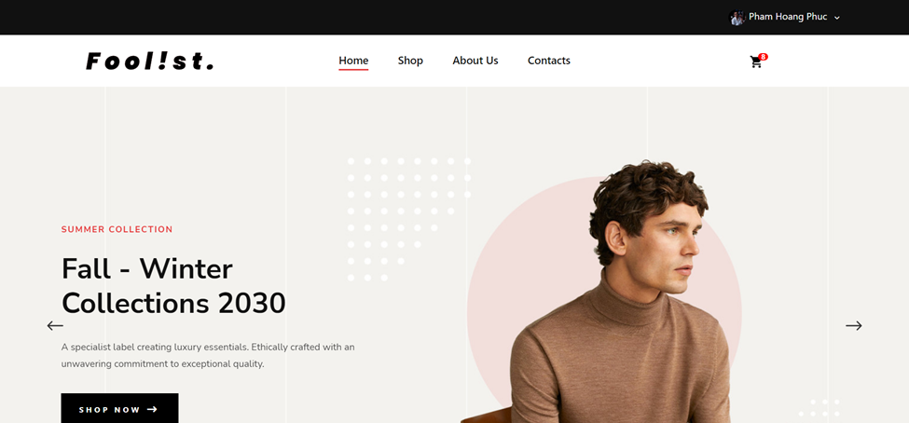
Local Shop Website Design
Fool!st. Brand
www.fool!stshop.com

Slide 3
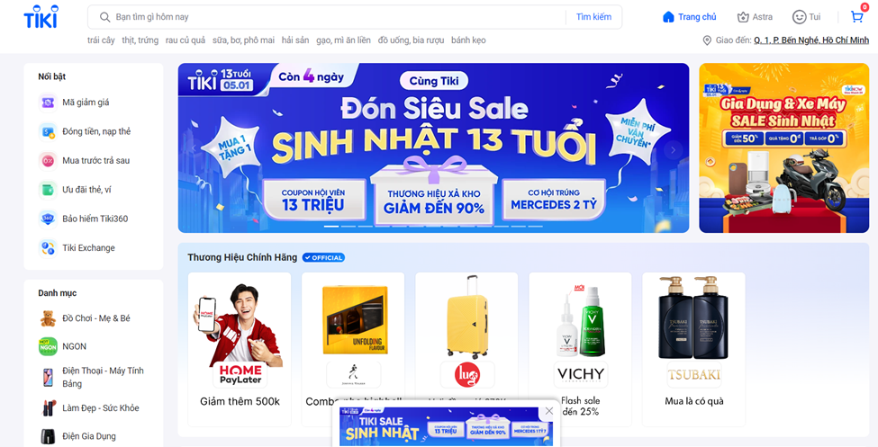
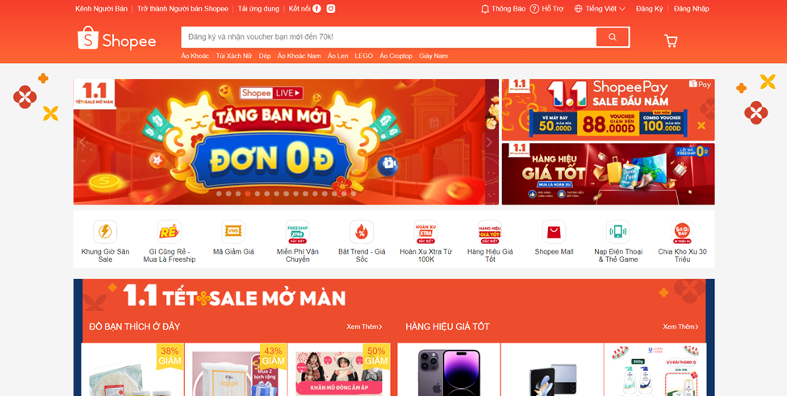
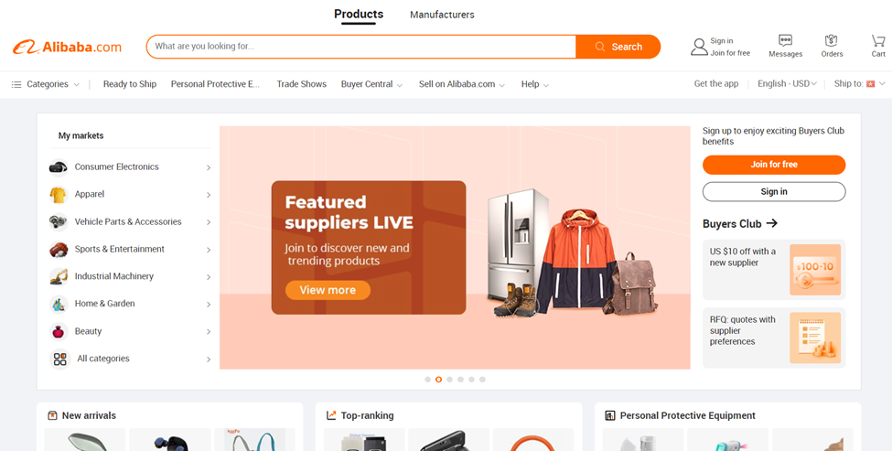
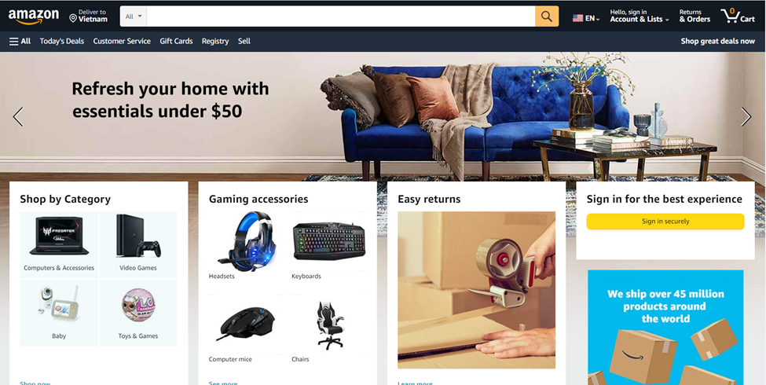
Introduction
System architechture
System design
Implementation
Conclusion
As the digital technology era develops, the trend of using online sales systems is also increasing.
The e-commerce market is also growing strongly, almost all products from essential necessities are also sold online through websites.
On the current market, there are many websites about e-commerce trading such as shopee, amazon, alibaba, tiki, .....
🡺 Based on the current trend, my team also designed a website for management and sales of clothing and fashion products
Fool!st. Brand
www.fool!stshop.com

Slide 4
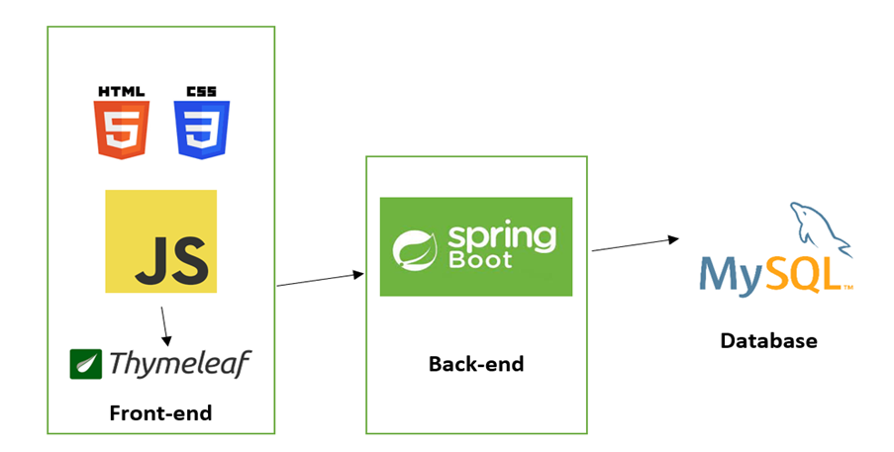
System architecture
Introduction
System design
Implementation
Conclusion
We use HTML/CSS and Javascript to develop application UI, then we use Thymeleaf as a mean of Front-end and Back-end communication, then JAVA Spring Boot will handle data and some logical events before making any update on MySQL database.
Fool!st. Brand
www.fool!stshop.com

Slide 5

JAVA Spring Boot
System architecture
Introduction
System design
Implementation
Conclusion
Java Spring Framework (Spring Framework) is a popular, open source, enterprise-level framework for creating standalone, production-grade applications that run on the Java Virtual Machine (JVM).
Java Spring Boot (Spring Boot) is a tool that makes developing web application and microservices with Spring Framework faster and easier through three core capabilities
Autoconfiguration
An opinionated approach to configuration
The ability to create standalone applications
Fool!st. Brand
www.fool!stshop.com

Slide 6


System architecture
Introduction
System design
Implementation
Conclusion
Thymeleaf & MySQL
Thymeleaf is a server-side Java-based template engine for both web and standalone environments, capable of processing HTML, XML, JavaScript, CSS and even plain text. It is more powerful than JPS and responsible for dynamic content rendering on UI.
MySQL is a fast, easy-to-use RDBMS being used for many small and big businesses. MySQL is developed, marketed and supported by MySQL AB, which is a Swedish company.
Fool!st. Brand
www.fool!stshop.com

Slide 7
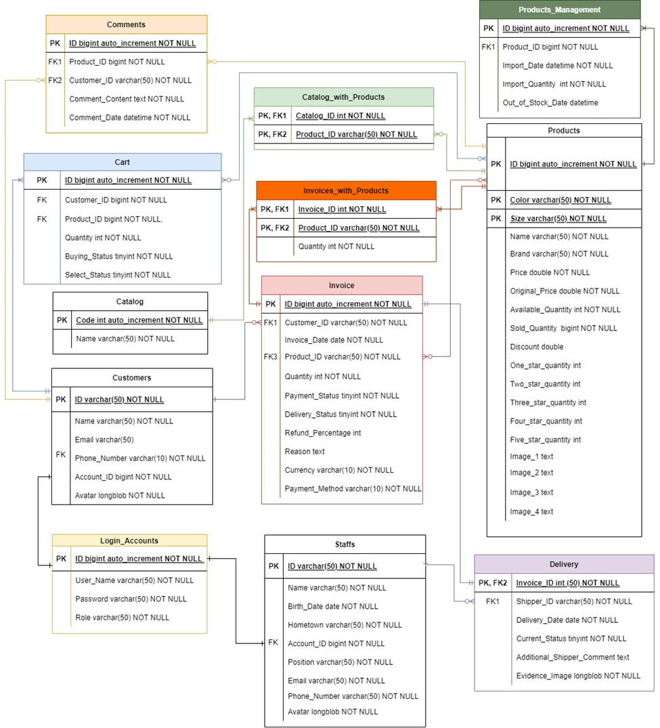
3.1. Database ERD

Slide 8
Introduction
System architechture
System design
Implementation
Conclusion
3.2. Interfaces
Home page
Fool!st. Brand
www.fool!stshop.com

Slide 9
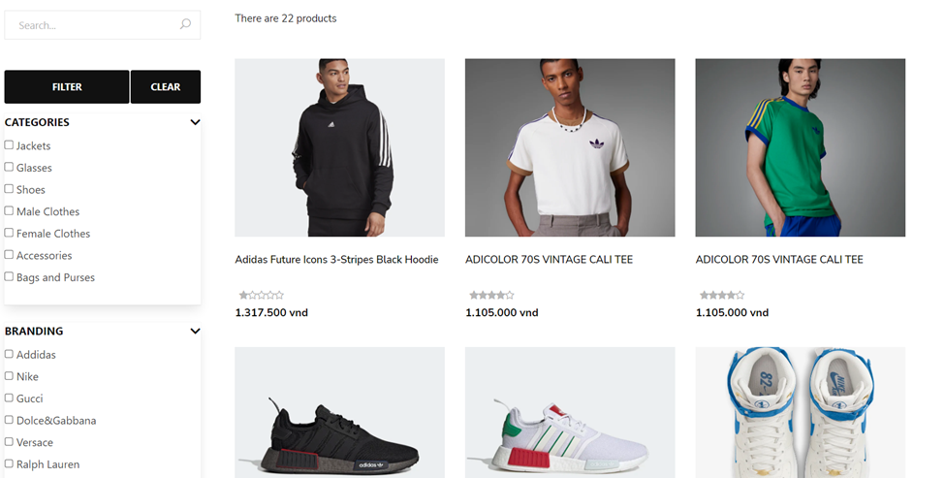
System design
Introduction
System architechture
Implementation
Conclusion
3.2. Interfaces
Shop page
Fool!st. Brand
www.fool!stshop.com

Slide 10


Implementation
Introduction
System architechture
System design
Conclusion
First we use eclipse IDE to code and run the program
Then we run database script at MySQL to generate database
Fool!st. Brand
www.fool!stshop.com

Slide 11
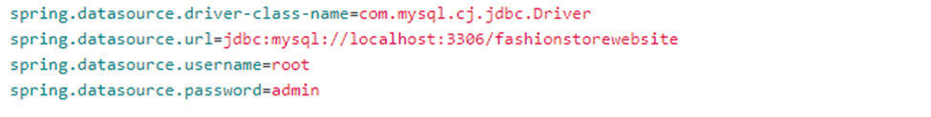
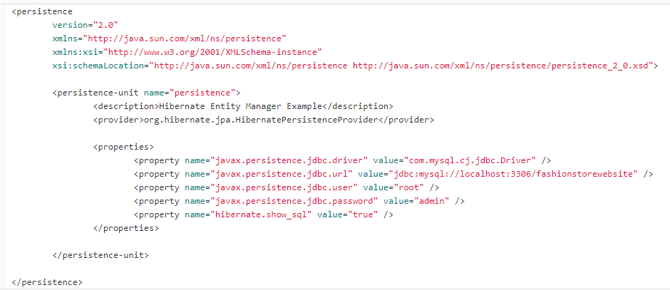
Implementation
Introduction
System architechture
System design
Conclusion
Then we edit database login user name and password or maybe the port we want localhost to run on at application.properties and persistence.xml file.
After all, we start server to run the website.
Fool!st. Brand
www.fool!stshop.com

Slide 12

Introduction
System architecture
Conclusion
System design
Implementation
Over the period of completing the graduation thesis, the group has successfully completed our objectives. In the process of doing the thesis, the group also learned and absorbed a lot of new knowledge through building the "Fashion shop ecommerce website" application using Spring boot, thymeleaf, in addition, there was good coordination among members while working on the project. job. Besides the results achieved, the application still has many things to overcome and improve, these are also the future development directions that the team is aiming for.
Fool!st. Brand
www.fool!stshop.com

Slide 13
Introduction
System architechture
Conclusion
System design
Implementation
Know the theory of Spring boot, mySql, thymeleaf. Learn how to build front-end websites and build databases and connect them.
Gain effective teamwork skills. Logical thinking is also significantly improved. Know how to start a project effectively and divide the work evenly among team members.
Project: Fashion shop ecommerce website with all functions that work well. Including three user types (administrator, delivery guy, user). Payment gateway diversity (global: Paypal). Beautiful interface and easy to use, simple and fast form of payment
4.1. Achievement
Fool!st. Brand
www.fool!stshop.com

Slide 14
4.2. Strengths and drawbacks
Introduction
System architechture
Conclusion
System design
Implementation
Drawbacks
On the other hand, regarding the interface, there are still many shortcomings in the design, so the application is only compatible with certain operating systems and platforms. The application is suitable for certain screen. In terms of functions, due to the lack of expertise and experience, the handling. logic and performance are not optimal.
Strengths
The website is designed with an easy-to-see and user-friendly interface. Simple operation and functions are easy to use with all objects. Can buy clothes, accessories easily, can view purchase history and cancel orders.
Fool!st. Brand
www.fool!stshop.com

Slide 15
Introduction
System architechture
System design
Implementation
Conclusion
4.3. Reflection gained
4.4. Future development direction
4.3. Reflection gained
Responsive website.
Learn how to manage source control, very good support in doing multi-person projects.
Create mobile version.
Improve website performance.
Learn new technology.
The team will work to improve the application and add more features in the future.
Fool!st. Brand
www.fool!stshop.com

Slide 16

Thanks!
Do you have any questions?
Please keep this slide for attribution

